Slide 1

N-W.F.P University of Engineering & Technology Peshawar
Subject CE-51111
Advanced Structural Analysis-1
Instructor: Prof. Dr. Shahzad Rahman

Slide 2
Topics to be Covered
Overview of Bernoulli-Euler Beam Theory
Overview of Theory of Torsion
Static Indeterminancy
Kinematic Indeterminancy

Slide 3
Bernoulli-Euler Beam Theory
Leonardo Da Vinci (1452-1519) established all of the essential features of the strain distribution in a beam while pondering the deformation of springs.
For the specific case of a rectangular cross-section, Da Vinci argued equal tensile and compressive strains at the outer fibers, the existence of a neutral surface, and a linear strain distribution.
Da Vinci did not have available to him Hooke's law and the calculus. So mathematical formulation had to wait till time of Bernoulli and Euler
In spite of Da Vinci’s accurate appreciation of the stresses and strains in a beam subject to bending, he did not provide any way of assessing the strength of a beam, knowing its dimensions, and the tensile strength of the material it was made of.

Slide 4
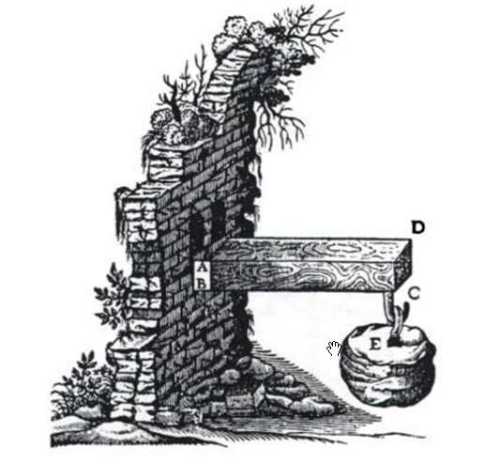
Bernoulli-Euler Beam Theory
This problem of beam strength was addressed by Galileo in 1638, in his well known “Dialogues concerning two new sciences. Illustrated with an alarmingly unstable looking cantilever beam.
Galileo assumed that the beam rotated about the base at its point of support, and that there was a uniform tensile stress across the beam section equal to the tensile strength of the material.

Slide 5
Bernoulli-Euler Beam Theory
The correct formula for beam bending was eventually derived by Antoine Parent in 1713 who correctly assumed a central neutral axis and linear stress distribution from tensile at the top face to equal and opposite compression at the bottom, thus deriving a correct elastic section modulus of the cross sectional area times the section depth divided by six.
Unfortunately Parent’s work had little impact, and it were Bernoulli and Euler who independently derived beam bending formulae and are credited with development of beam theory

Slide 6
Bernoulli-Euler Beam Theory
Leonhard Euler ( A Swiss Mathematician) and Daniel Bernoulli (a Dutch Mathematician) were the first to put together a useful theory circa 1750.
The elementary Euler-Bernoulli beam theory is a simplification of the linear isotropic theory of elasticity which allows quick calculation of the load-carrying capacity and deflection of common structural elements called beams.
At the time there was considerable doubt that a mathematical product of academia could be trusted for practical safety applications.
Bridges and buildings continued to be designed by precedent until the late 19th century, when the Eiffel Tower and the Ferris Wheel demonstrated the validity of the theory on a large scale.
it quickly became a cornerstone of engineering and an enabler of the Second Industrial Revolution. (1871-1914)

Slide 7
Bernoulli-Euler Beam Theory
Assumptions
The beam is long and slender.
Length >> width and length >> depth
therefore tensile/compressive stresses perpendicular
to the beam are
much smaller than tensile/compressive stresses
parallel to the beam.
The beam cross-section is constant along its axis.
The beam is loaded in its plane of symmetry.
Torsion = 0

Slide 8
Bernoulli-Euler Beam Theory
Assumptions
Deformations remain small. This simplifies the
theory of elasticity to its linear form.
no buckling
no plasticity
no soft materials.
Material is isotropic
Plane sections of the beam remain plane.
This was Bernoulli's critical contribution

Slide 9
Bernoulli-Euler Beam Theory
Derivation
b
d
P

Slide 10
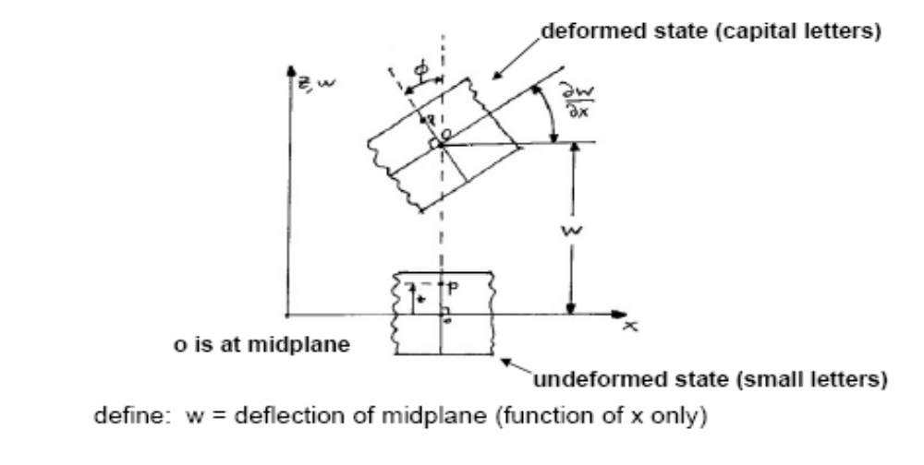
Bernoulli-Euler Beam Theory
Derivation
P

Slide 11
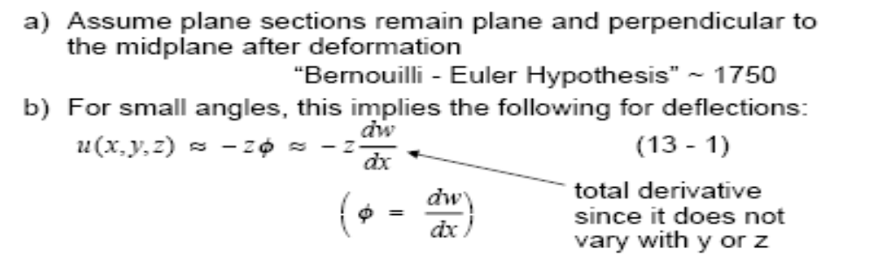
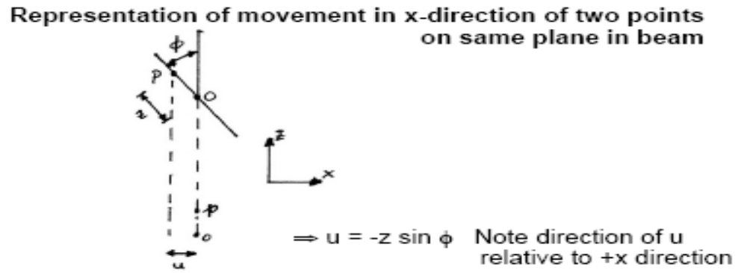
Bernoulli-Euler Beam Theory
Derivation

Slide 12
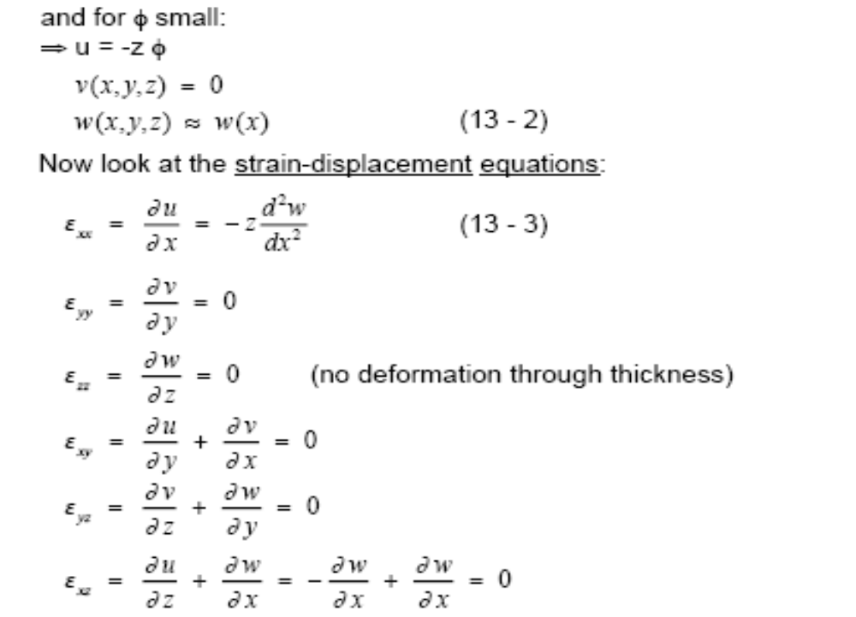
Bernoulli-Euler Beam Theory
Derivation

Slide 13
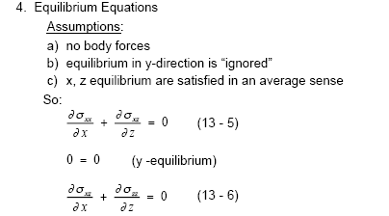
Bernoulli-Euler Beam Theory
Derivation

Slide 14
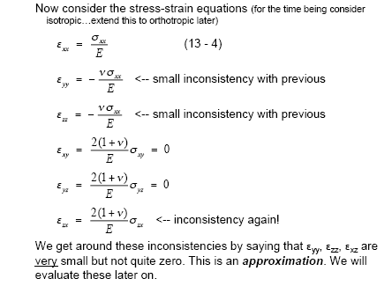
Bernoulli-Euler Beam Theory
Derivation

Slide 15
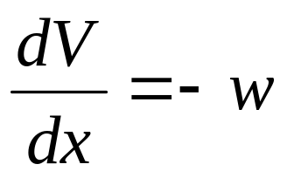
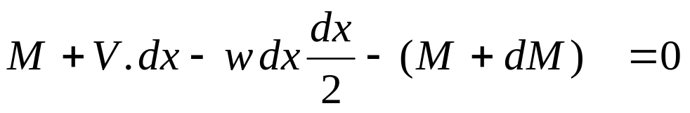
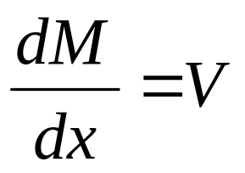
Bernoulli-Euler Beam Theory
Derivation: Equilibrium Equations
w
M
V
V + dv
M + dM
dx
V – w dx – ( V + dV) = 0
Neglect

Slide 16

Bernoulli-Euler Beam Theory
Derivation: Equilibrium Equations
P
P
w = P/dx
M
V
V 1
M
V
V 1
M + dM
M + dM
dx
dx
V – P – V1 = 0
Neglect
Abrupt Change in dM/dx at load Point P

Slide 17
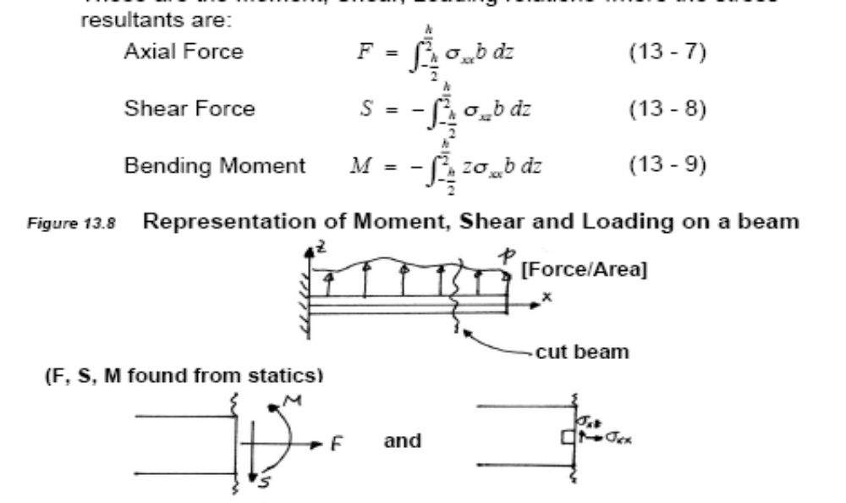
Bernoulli-Euler Beam Theory
Derivation

Slide 18
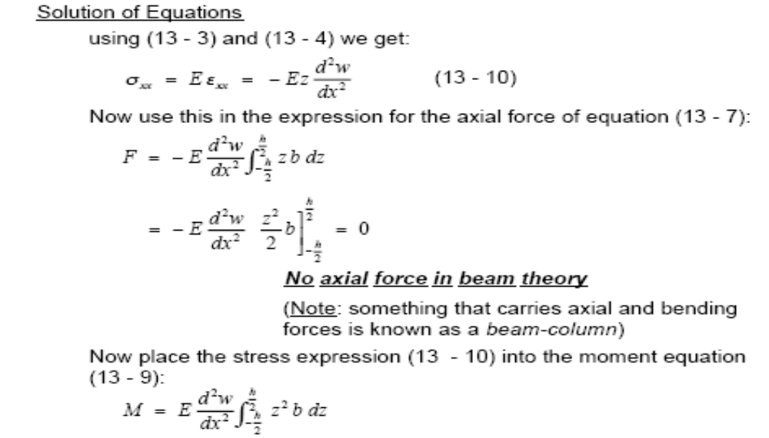
Bernoulli-Euler Beam Theory
Derivation

Slide 19
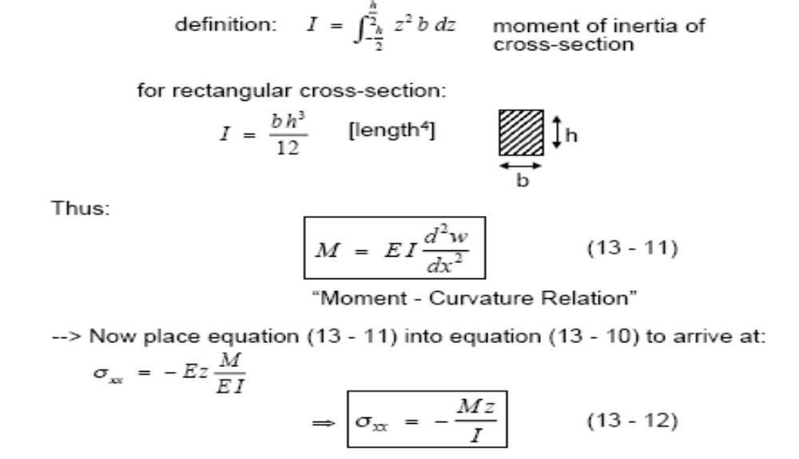
Bernoulli-Euler Beam Theory
Derivation

Slide 20
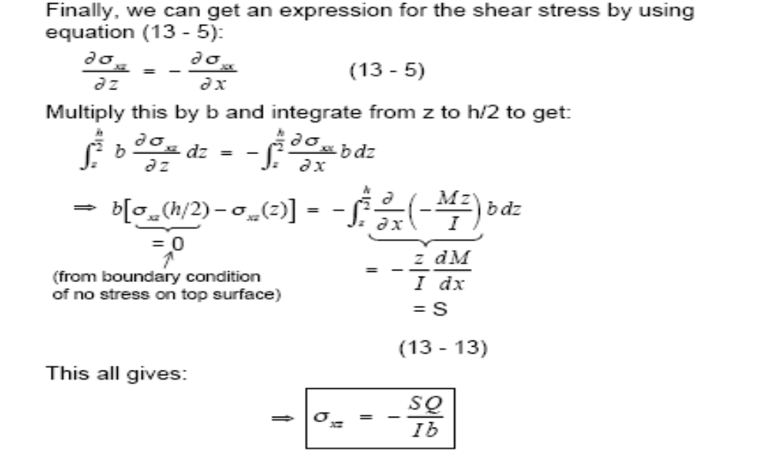
Bernoulli-Euler Beam Theory
Derivation

Slide 21
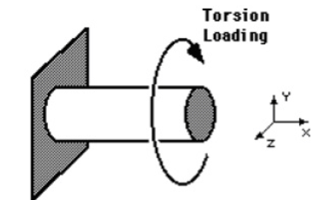
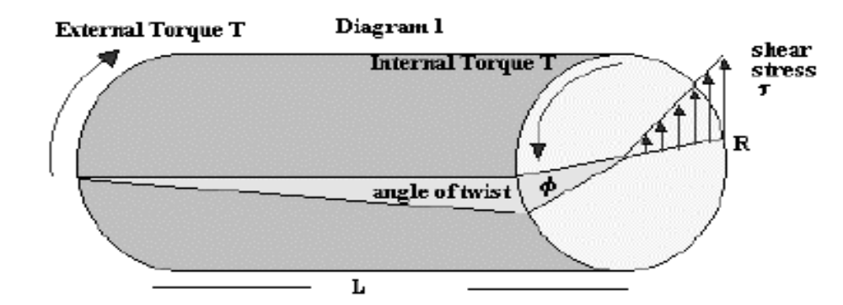
Theory of Torsion
Derivation

Slide 22
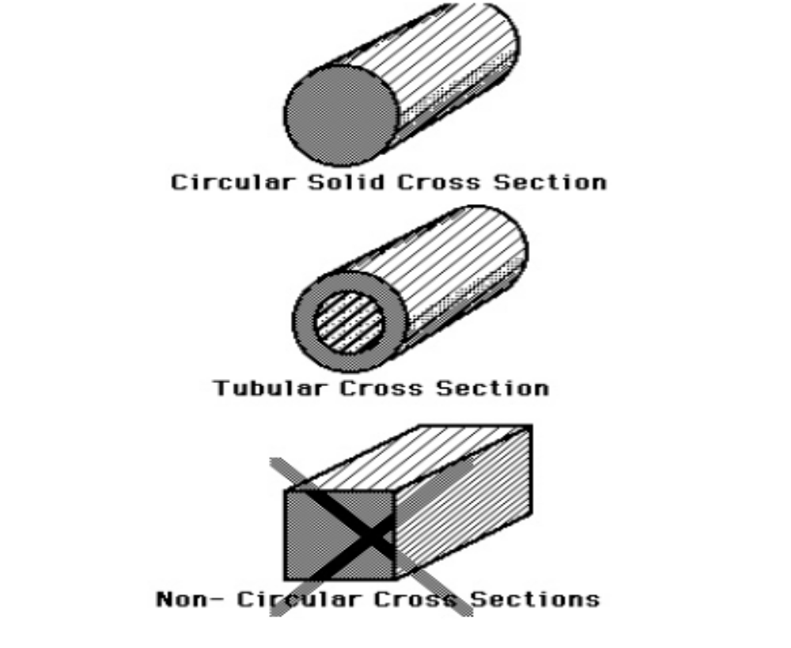
Theory of Torsion
Derivation

Slide 23
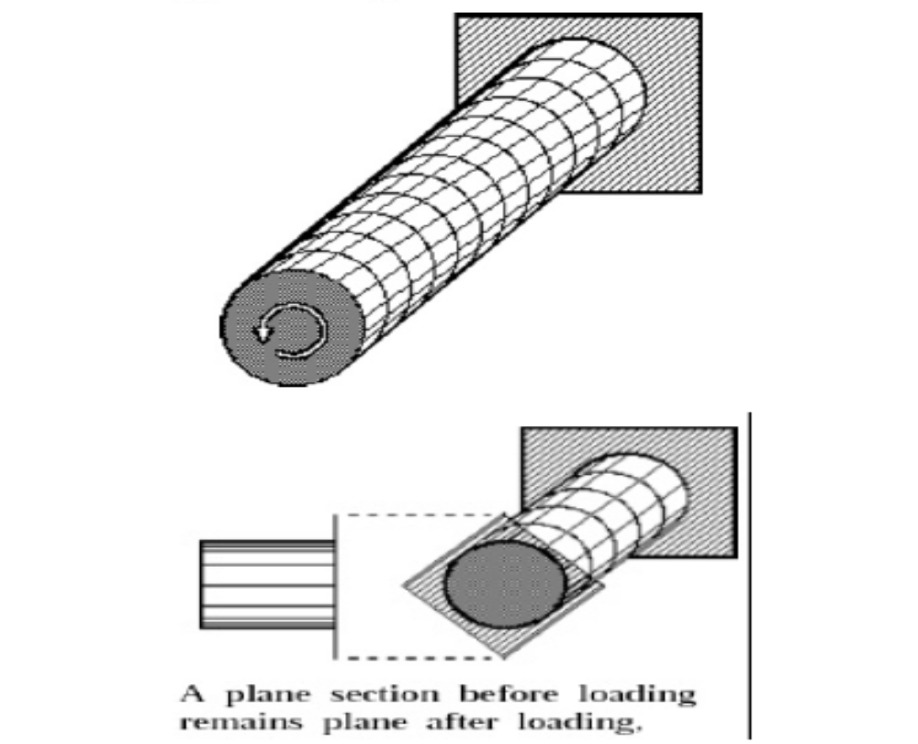
Theory of Torsion
Derivation

Slide 24
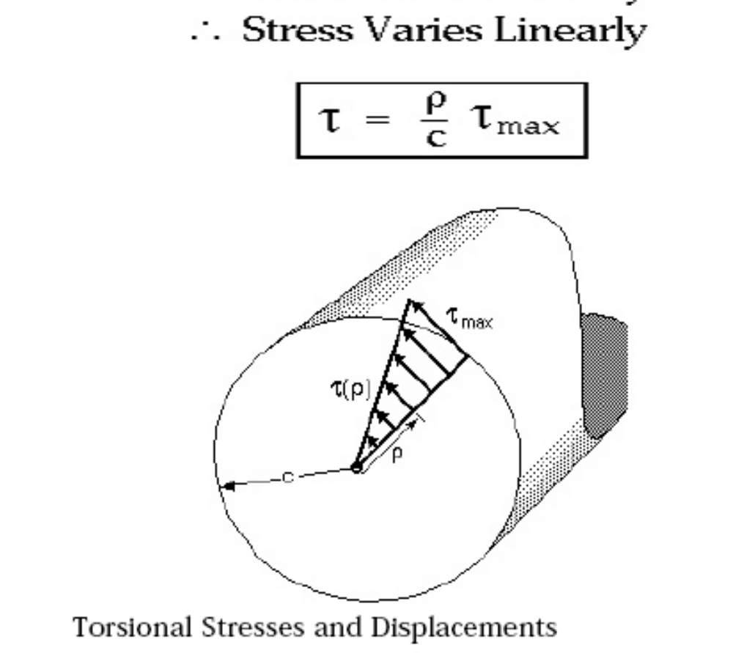
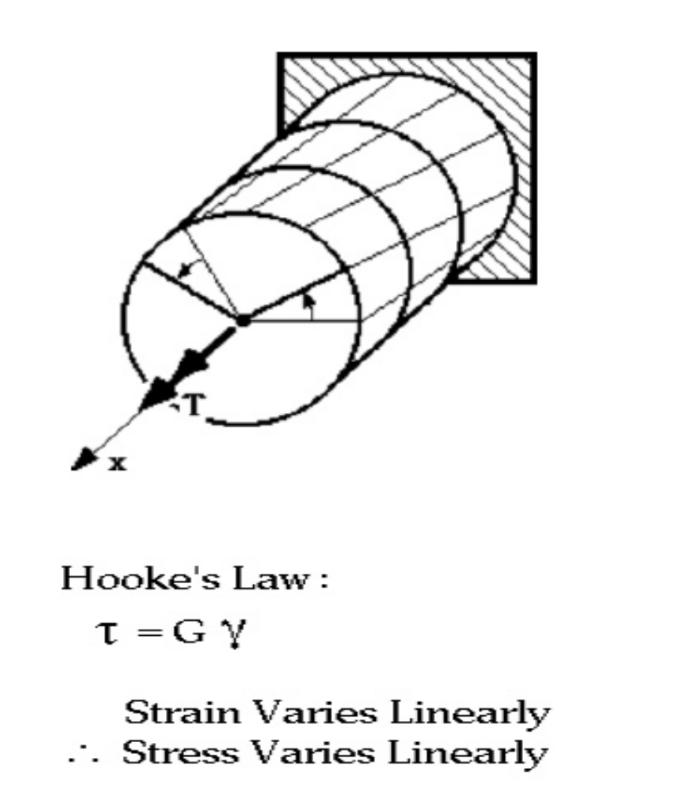
Theory of Torsion
Derivation

Slide 25
Theory of Torsion
Derivation
Torsion Formula
We want to find the maximum shear stress τmax which occurs in a circular shaft of radius c due to the application of a torque T. Using the assumptions above, we have, at any point r inside the shaft, the shear stress is τ_{r} = r/c τ_{max}.
∫τ_{r}dA r = T
∫ r²/c τmax dA = T
τ_{max}/c∫r² dA = T
Now, we know,
J = ∫ r² dA
is the polar moment of intertia of the cross sectional area J = πc⁴/2 for Solid Circular Shafts

Slide 26
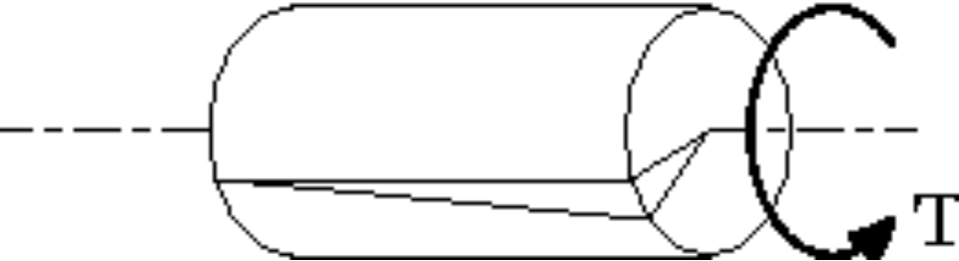

Theory of Torsion
Derivation
γ = τ/G
For a shaft of radius c, we have
φ c = γ L
where L is the length of the shaft. Now, τ is given by
τ = Tc/J
so that
φ = TL/GJ

Slide 27
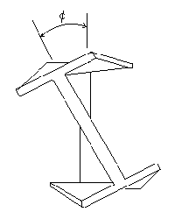
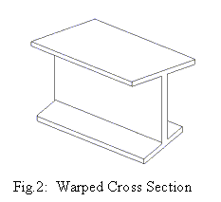
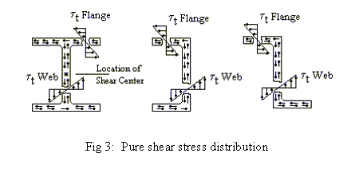
Theory of Torsion
Fig. 1: Rotated Section

Slide 28
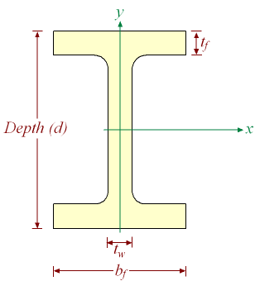
Theory of Torsion
Torsional Constant for an I Beam
For an open section, the torsion constant is as follows:
J = Σ(bt³ / 3)
So for an I-beam
J = (2btf³ + (d - 2tf)tw³) / 3
where
b = flange width
tf = flange thickness
d = beam depth
tw = web thickness

Slide 29
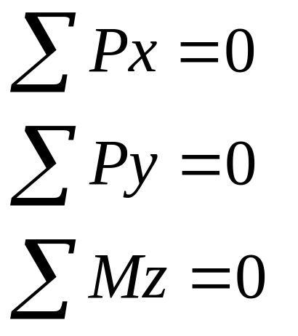
Static Determinancy
Equilibrium of a Body
y
x
z
Three Equations so Three Unknown Reactions (ra)
can be solved for

Slide 30
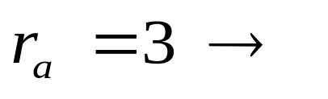
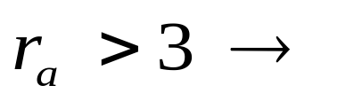
Static Determinancy
y
x
z
Structure Statically Determinate Externally
Structure Statically Indeterminate Externally

Slide 31
Static Determinancy
ra = 3, Determinate, Stable
ra > 3, Determinate, Stable
ra > 3, Indeterminate, Unstable
ra =3, Unstable

Slide 32
Kinematic Determinancy and Indeterminancy
Kinematic Indeterminancy (KI) = 1
Kinematically Determinate, KI = 0
KI = 5

